Slide 1
Greenhouse gas emission analysis
By
Satish Gollu
Sri Surya Sameer Vaddhiparthy
Under the guidance of Dr. Wassnaa Al- Mawee

Slide 2
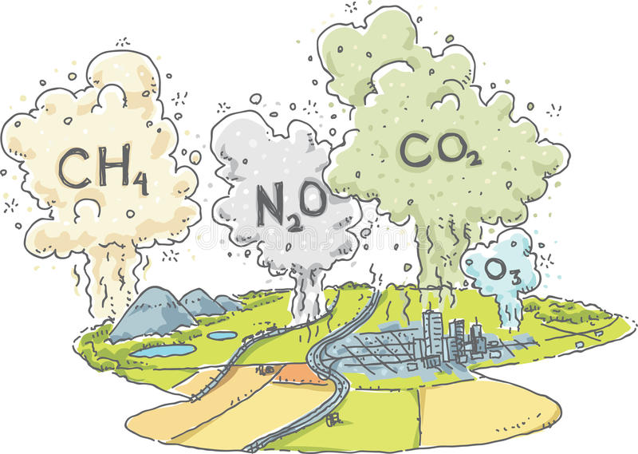
Overview
Issue: Over the years, around the world with increasing of technology and ease of human life, there are tons of hazards gases that are emitted to the atmosphere and in order to control or initiate steps to minimize the emissions and need to have an idea which countries are responsible for these high emissions.
Action Plan: analyze the green house gas emissions data of which countries are producing high amount of gases and what are the factors that are affecting and which gases are high in emission over the years.
Dataset source: http://data.un.org/Explorer.aspx

Slide 3
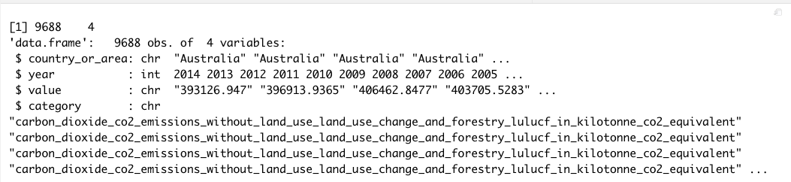
Dataset Description
Data Set Characteristics | Multivariate | Number of Rows | 9688
Associated Tasks: | Exploratory Data analysis | Number of Columns | 4

Slide 4
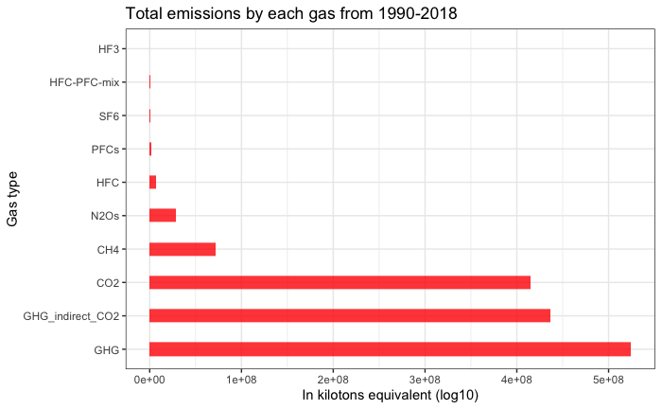

Overall gas emissions

Slide 5
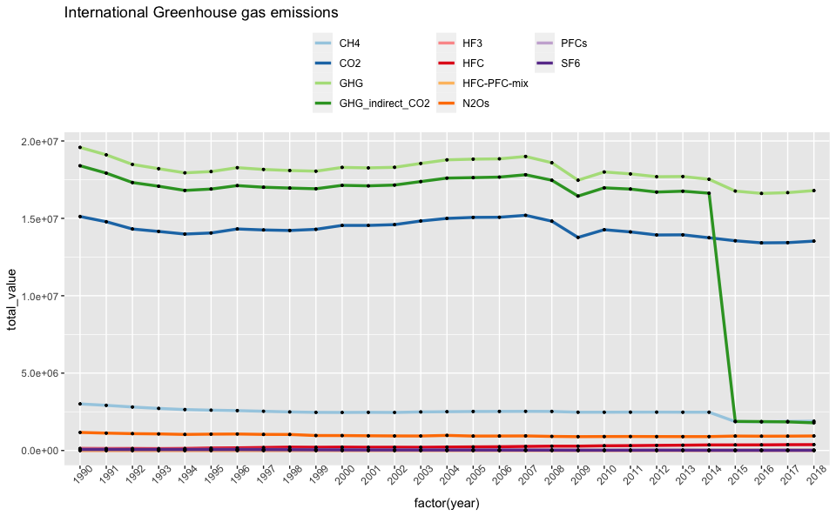

Year wise gas emissions

Slide 6
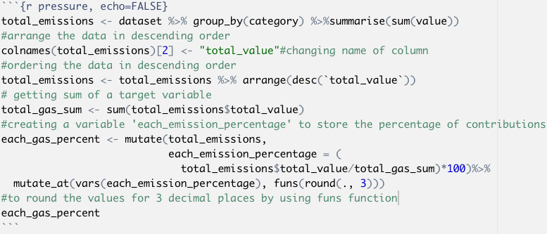
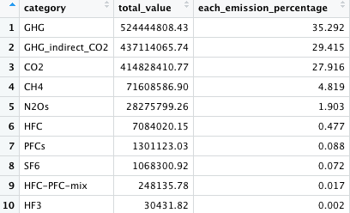
Contribution of each gas (1990-2018)

Slide 7
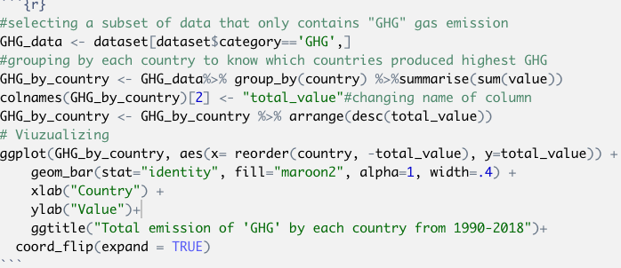
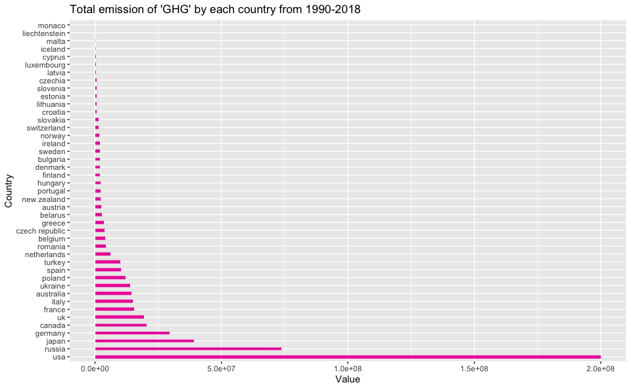
Gas wise Analysis Analysis of GHG Emission

Slide 8
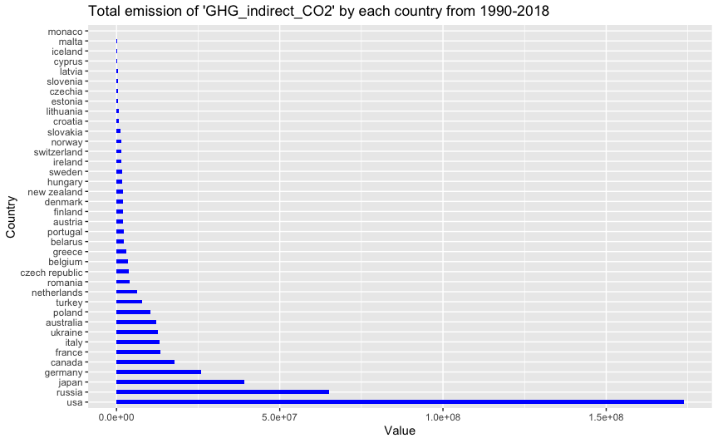
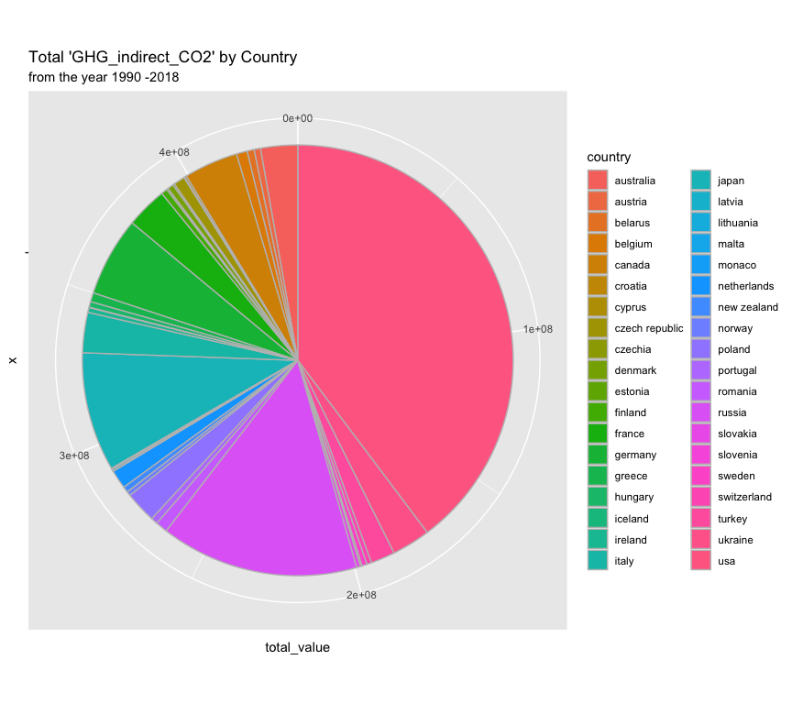

Slide 9
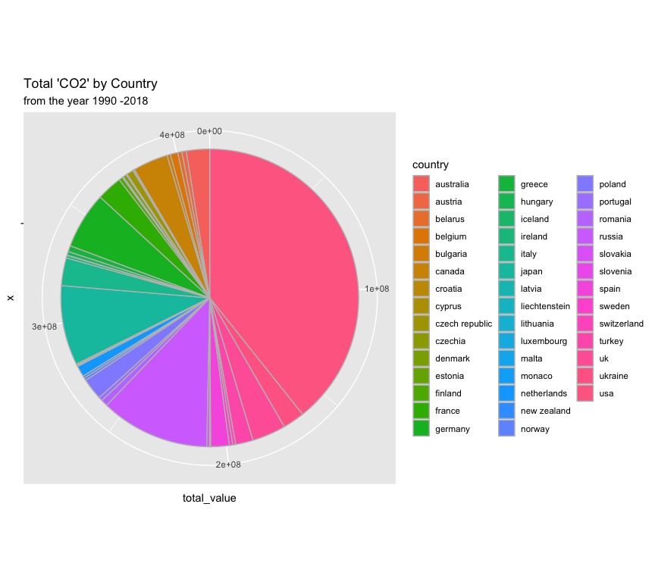
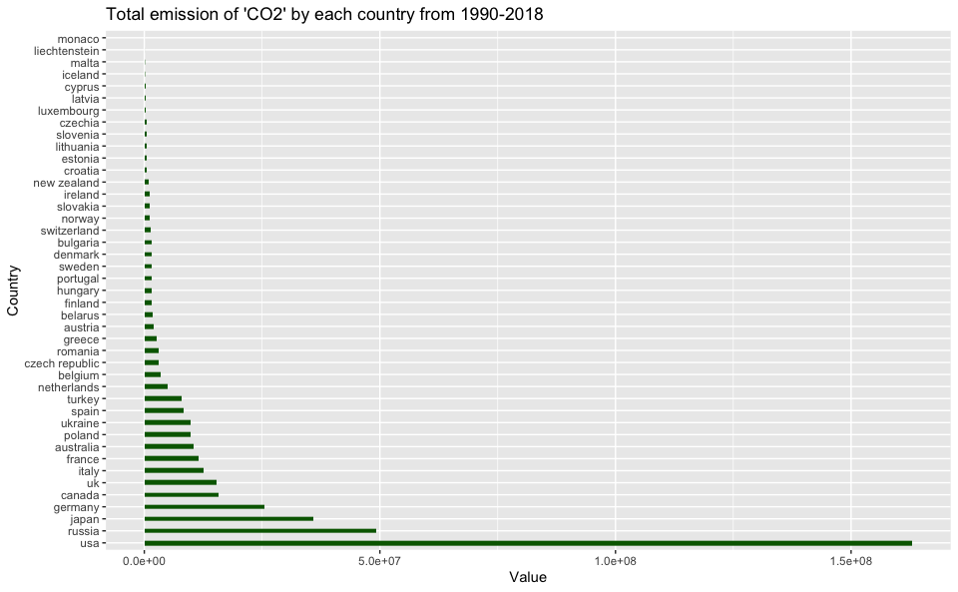

Slide 10
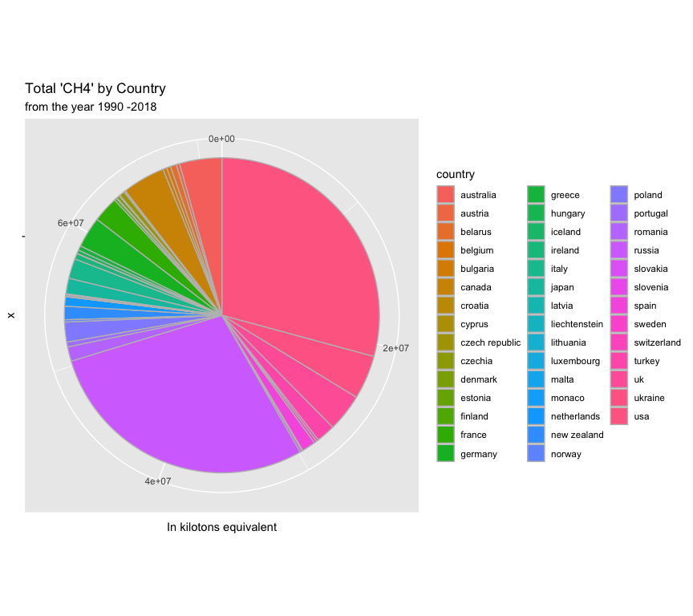
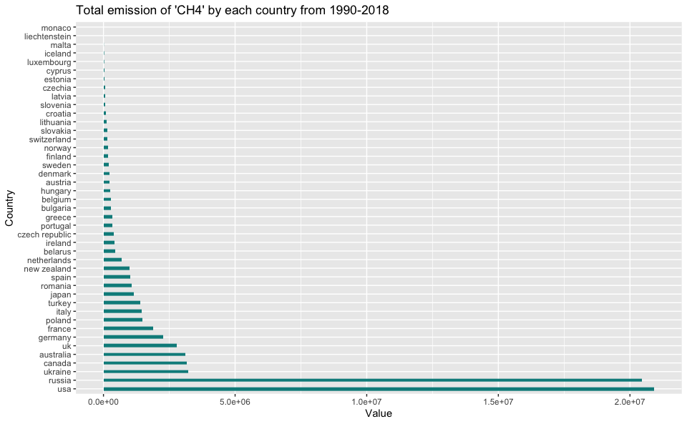

Slide 11
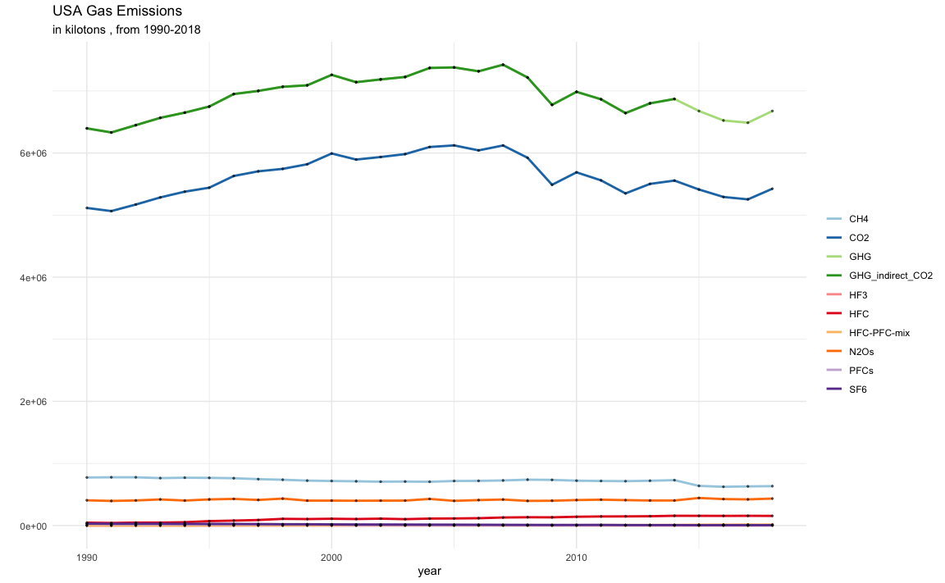
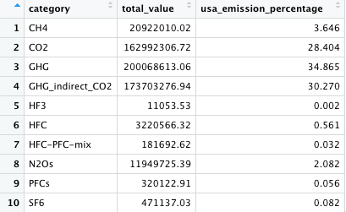
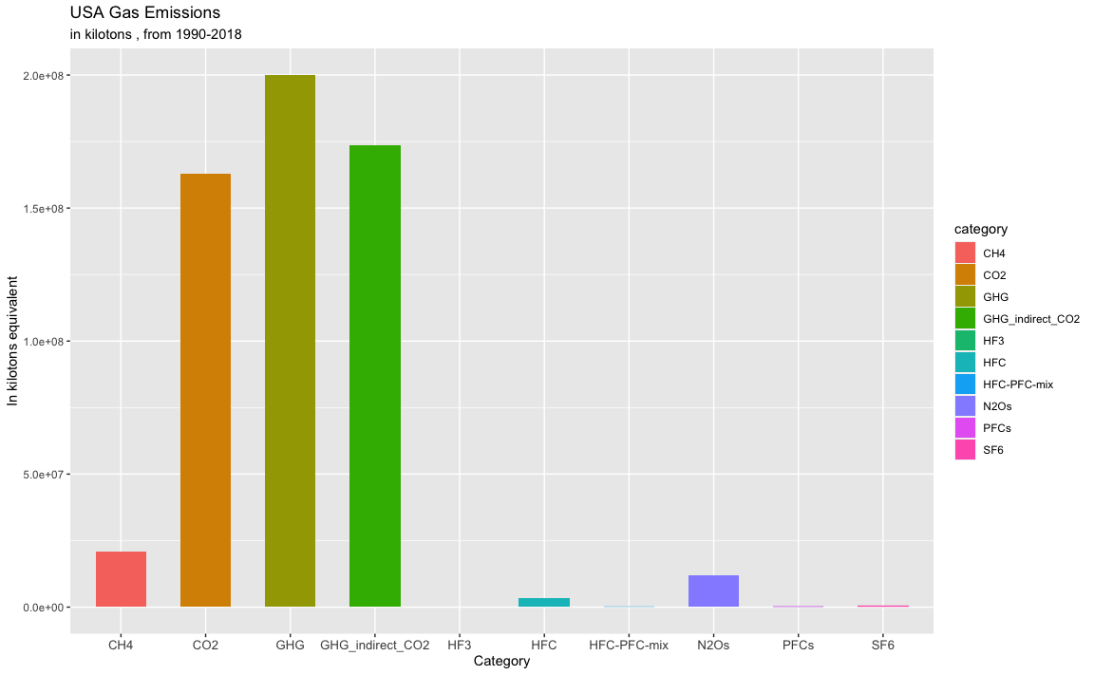

Slide 12
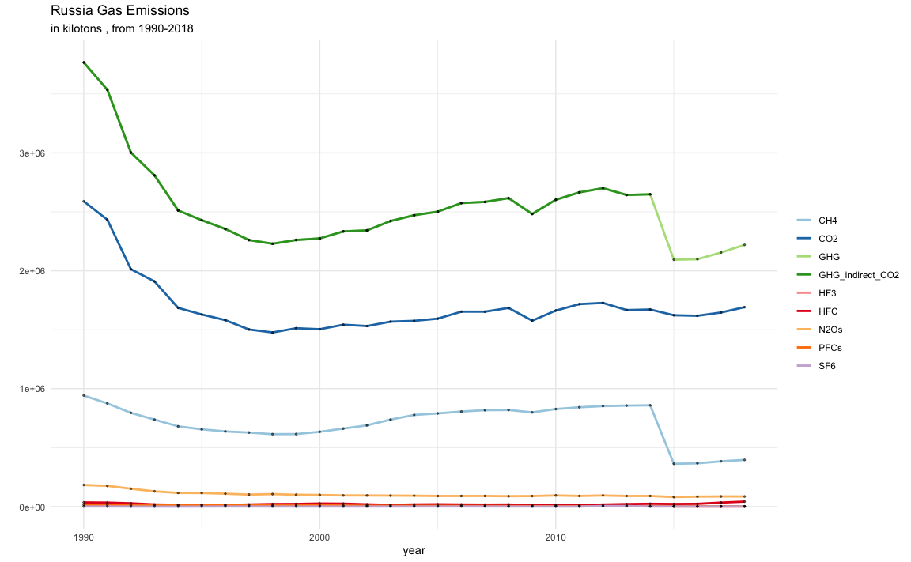
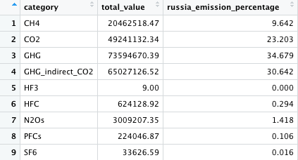
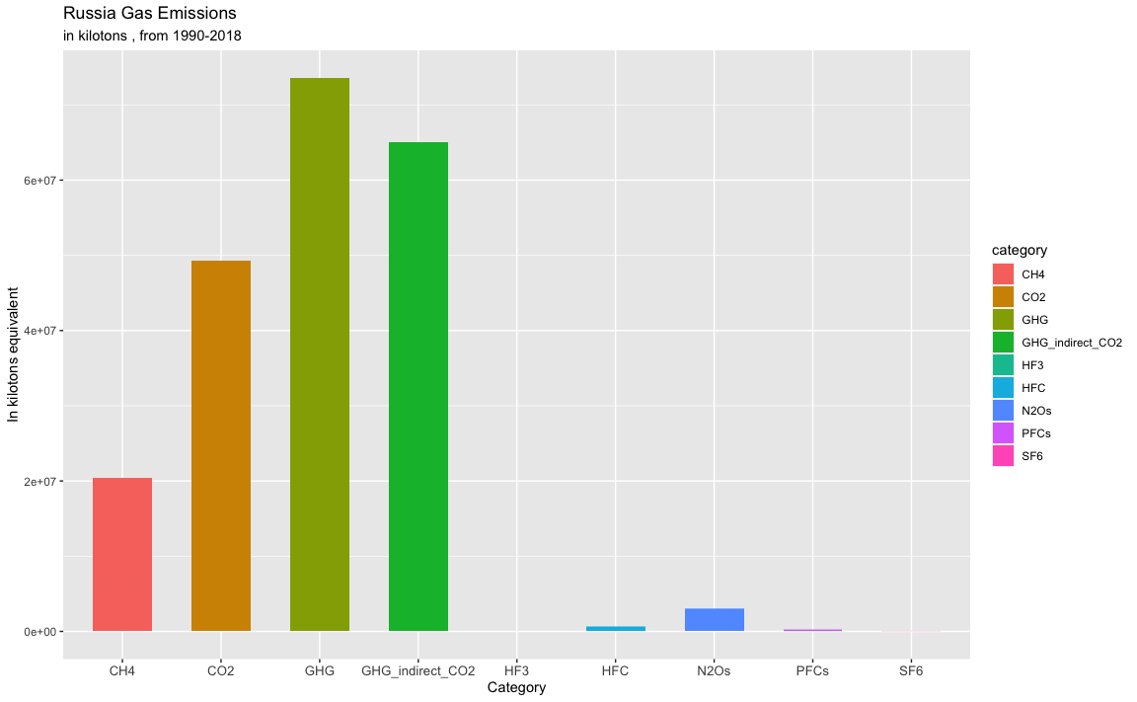

Slide 13
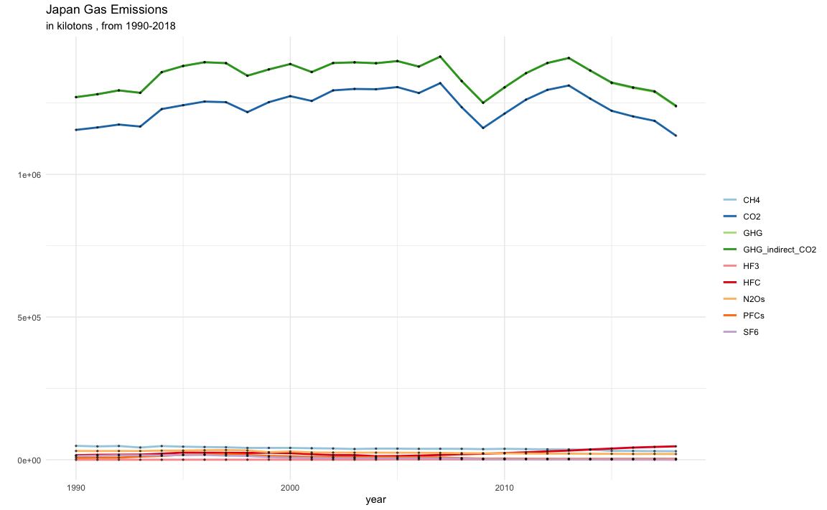
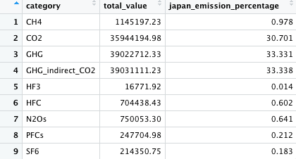
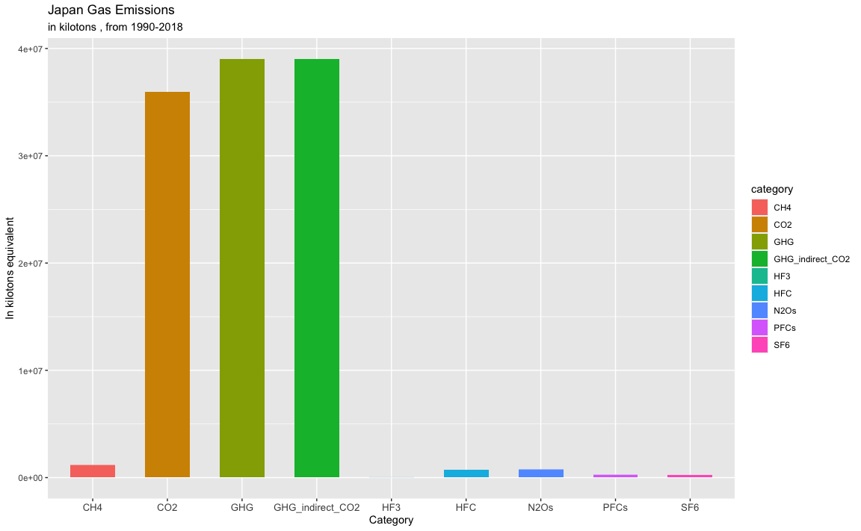

Slide 14
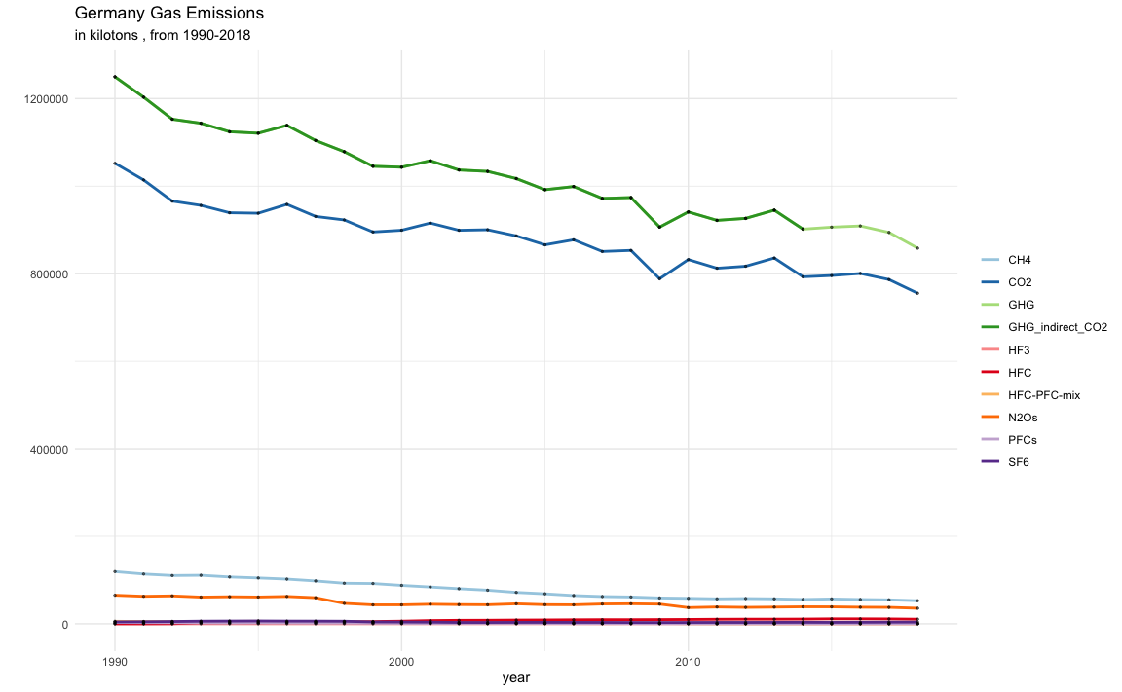
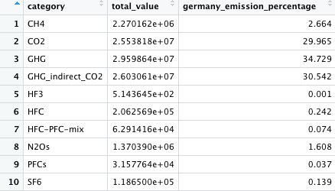
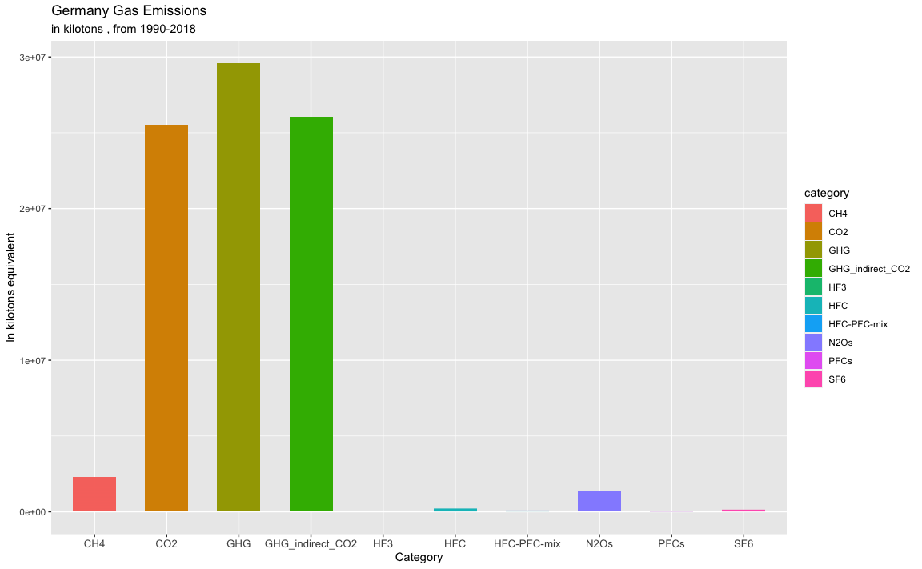

Slide 15
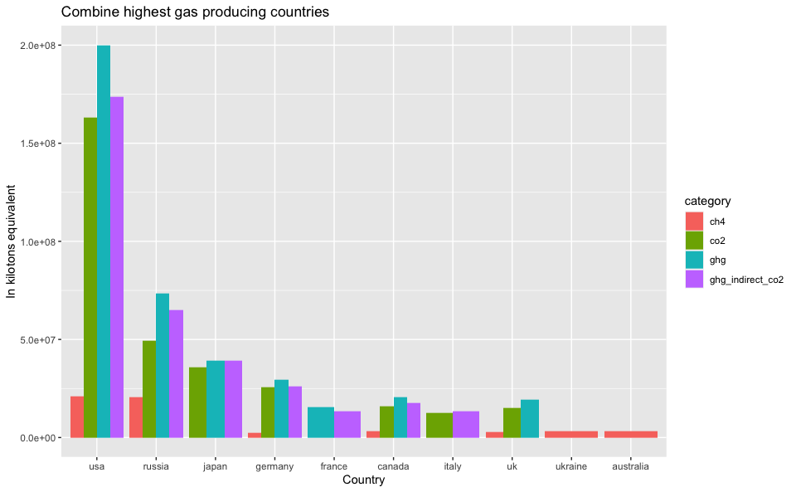

Slide 16
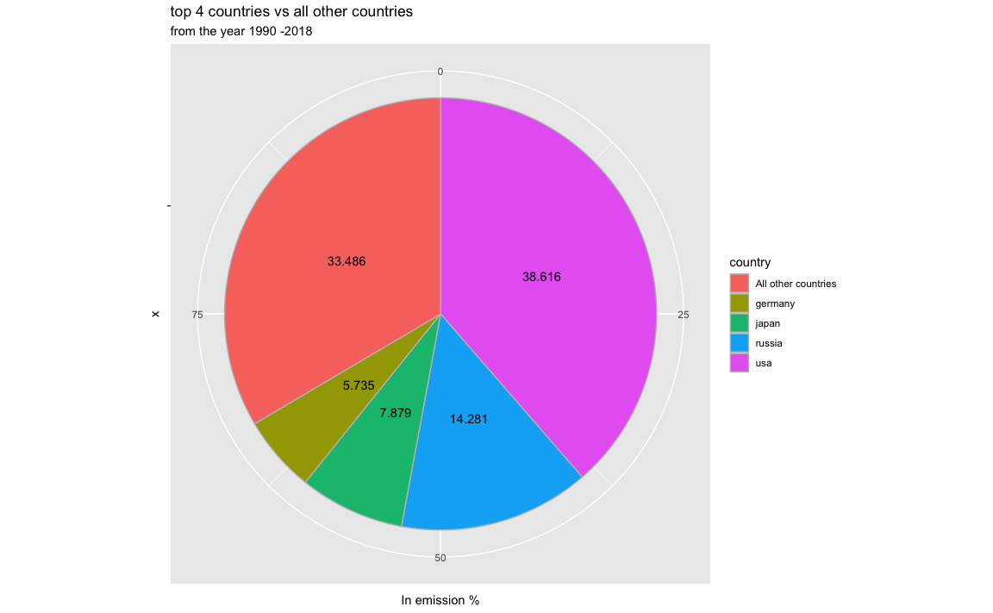
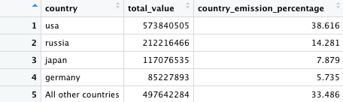
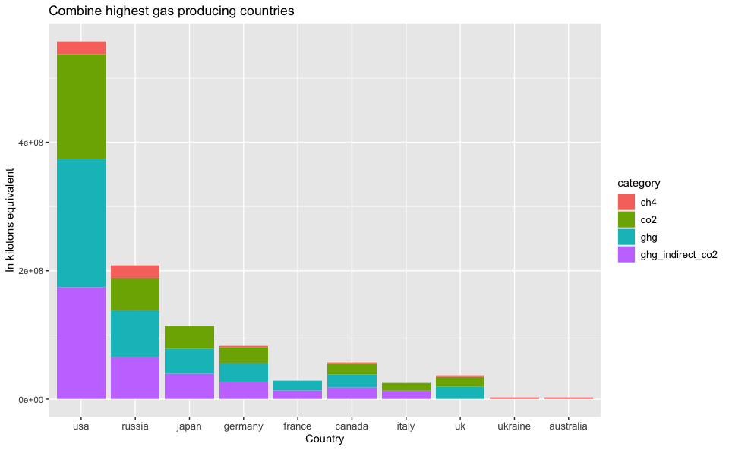

Slide 17
Key Conclusions
From the year 1990 - 2018, around the world the total amount of gas emission is ‘1486003683’ kilotons.
There are 4 gases which contributes a large amount of emission, they are i) GHG ii) GHG_indirect_CO2 iii) CO2 iv) CH4
“GHG”contributes 35.29% of total emission from the year 1990 - 2018, followed by ‘GHG_indirect_CO2’ which accounts for 29.41% of total emission and ‘CO2’ accounts for 27.91% of total emission and ‘CH4’ contributes to 4.81% of total emissions.
Out of total 10 different gases, these 4 gases combined contributing 97.42% of gas emissions where rest of gases contributing 2.58%

Slide 18
out of all countries, these 4 countries together producing 66.52% of total emissions which is huge and out of 66.52% of emissions, USA itself producing 38.62% of total emissions which has major impact to the environment followed by Russia which contributes 14.28% of emission.
in general, the largest source of greenhouse gas emissions from human activities is from burning fossil fuels for electricity, heat, and transportation.
these 4 countries are major manufacturers and exports of industries includes automobiles, consumer electronics, computers, aerospace, semiconductors, and iron and steel.

Slide 19
By initiating controlling of gas emissions with these 4 countries will bring down the overall global impact.
if these 4 countries can adapt to renewable energy to store the power of wind, sun, water, tides and other planetary resources like geothermal heat, which comes from the Earth’s core to produce electric power.
Agricultural “biomass” products also can be used to generate electricity and heat.
Renewables generate electricity without producing greenhouse gases—or producing very little when compared to traditional energy sources.
Using recycled materials will also help to minimize the greenhouse gas emissions
This is the best way to work around to minimize the greenhouse gas emissions.

Slide 20
Thank
You.

